Slide 1
JOURNAL CLUB 2
Development and validation of prediction models for mechanical ventilation, renal replacement therapy, and readmission in COVID-19 patients.
A.A 2021/2022
Lorenzo De Feo
Eleonora Trapani

Slide 2


Introduction of the problem
In the early phase of the pandemic, hospitals in hard-hit regions, such as the New York Metropolitan Area, suffered large caseloads which heavily strained medical resources.
The increase of the cases across the country continue to drive spending on medical resources.

Slide 3
In this setting, delivering optimal care to COVID- 19 patients will require matching scarce resources to patients.
Efficient distribution of resources will depend critically on prognostic assessments for new patients
With accurate prognostication, patient needs may be anticipated and met with the necessary equipment and provider experience to limit disease progression or limit adverse outcomes.
In this study, they developed, validated, and analyzed predictive models for the prognostication of 3 prevalent outcomes in the setting of COVID-19.
Notes:
The surge in cases throughout the country continues to drive medical resource expenditure, exhausting limited supplies. In this setting, delivering optimal care to COVID- 19 patients will require matching scarce resources to patients in need across hospital systems, cities, and even across the country. Efficient distribution of resources will depend critically on prognostic assessments for newly presenting patients. With accurate prognostication, patient needs may be anticipated and met with the necessary equipment and provider expertise to limit disease progression or guard against avoidable adverse outcomes. In this study, we develop, validate, and analyze predictive models for the prognostication of 3 prevalent and actionable adverse outcomes in the setting of COVID-19.
-------
L'impennata dei casi in tutto il paese continua a spingere la spesa per le risorse mediche, esaurendo le scorte limitate. In questo contesto, fornire un'assistenza ottimale ai pazienti COVID-19 richiederà di far corrispondere le scarse risorse ai pazienti che ne hanno bisogno nei sistemi ospedalieri, nelle città e persino in tutto il paese. Una distribuzione efficiente delle risorse dipenderà in modo critico dalle valutazioni prognostiche per i nuovi pazienti che si presentano. Con una prognosi accurata, i bisogni dei pazienti possono essere anticipati e soddisfatti con l'attrezzatura necessaria e l'esperienza dell'operatore per limitare la progressione della malattia o per evitare esiti avversi evitabili. In questo studio, sviluppiamo, convalidiamo e analizziamo modelli predittivi per la prognosi di 3 esiti avversi prevalenti e perseguibili nell'impostazione di COVID-19.

Slide 4


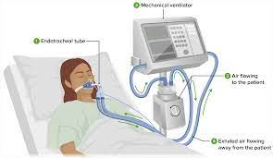
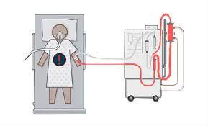
OBJECTIVE
The aim is to build interpretable prognostic models for covid-19 patients that estimate the risk of ARF requiring mechanical ventilation, AKI requiring RRT, and hospital readmission.
mechanical ventilation (MV)
renal replacement therapy (RRT)
hospital readmission

Slide 5
Dataset Description
4. Treatment of missing value
1. Data sources and patient population
3. Attribute selection
2. Attribute analysis

Slide 6


DATA SOURCES AND PATIENT POPULATION
In the article are considered the patients positive, polymerase chain reaction–based SARS-CoV-2 test during their hospital course between March 2 and May 6 2020, with:
room visits,
hospital admissions,
or both
The models using electronic health record (EHR) data
Model Development
Model Validation
Data from:
Columbia University Irving Medical Center/NewYork-Presbyterian (CUIMC/NYP)
including Milstein Hospital
the Morgan Stanley Children’s Hospital.
Data from:
NYP Allen Hospital, a community hospital member of NYP

Slide 7
ATTRIBUTE ANALYSIS
The dataset include:
demographics
conditions
smoking status
Clinical laboratory test results
vital signs
STANDARDIZED
BINARY CODING

Slide 8
ATTRIBUTE SELECTION
For RRT and mechanical ventilation models:
Used data collected during the first 12 hours of the current hospital course, because:
The 12- hour constraint is meant to exclude early events
This constraint also removes episodes occurring prior to a patient’s arrival in the hospital
Included data from patients’ prior visits.
For readmission models:
Considered the same attribute
Extended the data collecting period, not just the first 12 hours
Included in the feature only the condition that appears if only in 5 patients.
Not excluded patients who died during the clinical treatment
Notes:
Spiegazione delle 12 ore:
The 12- hour constraint is meant to exclude early events, which are likely to be anticipated on presentation and are therefore less likely to be intervened upon based on the output from a predictive model.
This constraint also removes episodes occurring prior to a patient’s arrival at the hospital; such events must be excluded to permit construction of prognostic models.

Slide 9
MISSING VALUE
For numerical variables, imputed missing values using Scikit-learn’s implementation of the MICE algorithm.
For categorical variables imputed missing values using the most common class in the training set.

Slide 10
model
Using:
L1-penalized logistic regression (logistic L1)
Elastic-net logistic regression (logistic EN)
Gradient boosted trees (GBT)
Logistic L1 and logistic EN have a hyperparameter $α$ (controls the strength of regularization). In addition, logistic EN has a second hyperparameter which controls the relative weight of the L1 vs L2 penalties.
For the GBT was used the default hyperparameter setting.
Notes:
The first two model is based on logistic regression. The last one is a nonparametric models that have also shown strong clinical prediction performance.
Vedi Link: https://towardsdatascience.com/l1-and-l2-regularization-methods-ce25e7fc831c
A regression model that uses L1 regularization technique is called Lasso Regression and model which uses L2 is called Ridge Regression.

Slide 11
Model selection
The model selection approach based on 2 performance metrics:
the area under the receiver-operating characteristic curve (AUROC)
the area under the precision-recall curve (AUPRC)
For each model and outcome, they conducted 5-fold cross validation on the development cohort data searching across different hyperparameters.
Notes:
For each model and outcome, they conducted 5-fold cross validation on the development cohort data searching across different hyperparameters
(alpha: [0.3, 0.5, 0.7]; mixing: [1 x 10^(-4), 1 x 10^4] equally spaced range of 10 values).
They select the model with the best average AUROC across all folds.
For the selected model, they compute the mean AUROC and AUPRC across all folds.

Slide 12
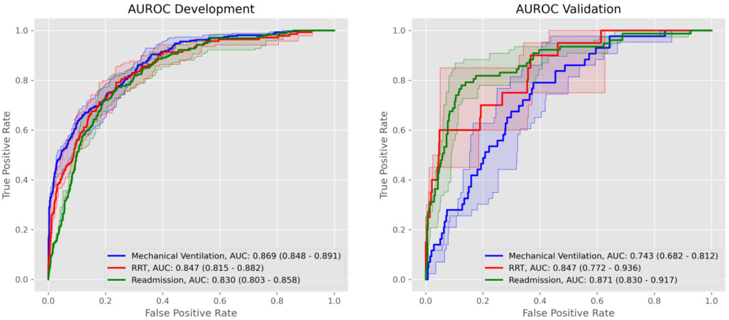
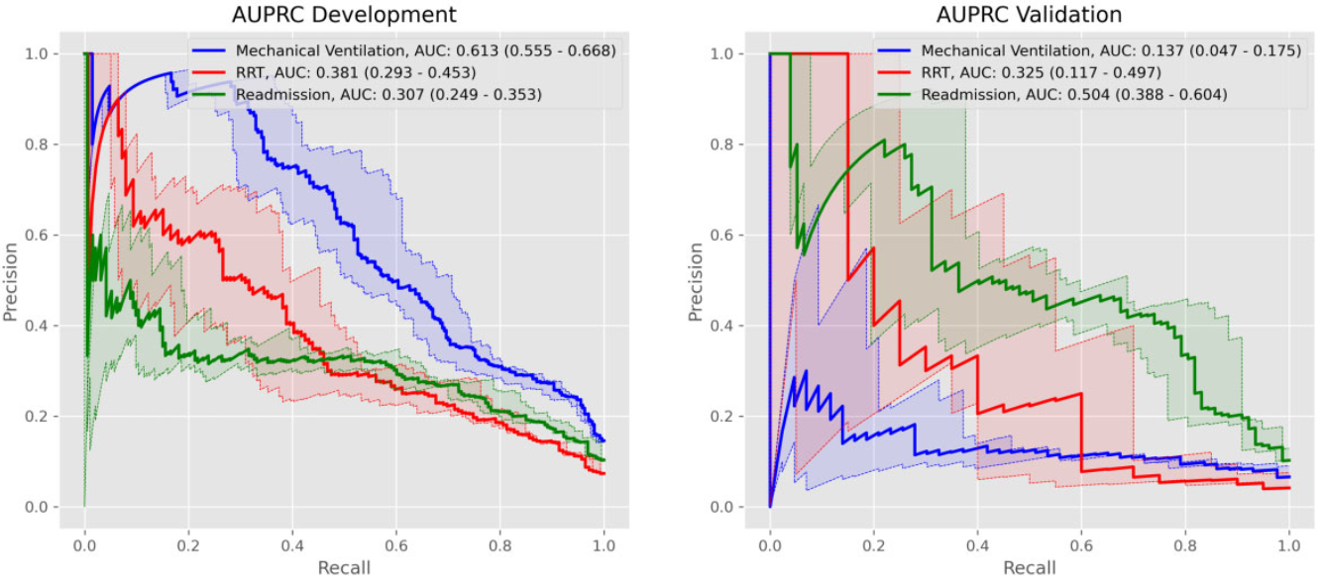
HYPERPARAMETERS
TUNING
The hyperparameters are:
alpha: [0.3, 0.5, 0.7];
mixing: [1 x 10⁻⁴, 1 x 10⁴]
equally spaced range of 10 values.
Was selected the model with the best average AUROC across all folds. For the selected model, we compute the mean AUROC and AUPRC across all folds.
Notes:
For each model and outcome, they conducted 5-fold cross validation on the development cohort data searching across different hyperparameters:
(alpha: [0.3, 0.5, 0.7]; mixing: [1 x 10^(-4), 1 x 10^4] equally spaced range of 10 values).
They select the model with the best average AUROC across all folds.
For the selected model, they compute the mean AUROC and AUPRC across all folds.

Slide 13
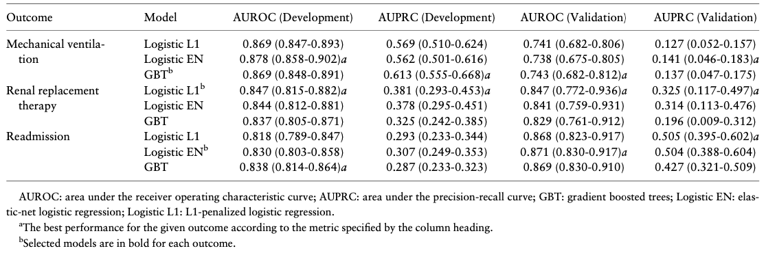
Model performance in development cohort
Used logistic L1 for all remaining RRT prediction experiments.
Used GBT for mechanical ventilation
Used logistic EN for readmission
Notes:
The models with best AUROC:
for mechanical ventilation → logistic EN (0.878 [95% CI, 0.858-0.902])
RRT → logistic L1 (0.847 [95% CI, 0.815- 0.882])
and readmission → GBT (0.838 [95% CI, 0.814-0.864]), respectively.
The best performing models according to AUPRC:
for mechanical ventilation → GBT (0.613 [95% CI, 0.555-0.668])
RRT → logistic L1 (0.381 [95% CI 0.293-0.453])
and readmission → logistic EN (0.307 [95% CI, 0.249-0.353]), respectively.
SELECTED MODEL:
RRT: Logistic L1 achieved the highest AUROC and AUPRC for RRT prediction; we use logistic L1 for all remaining RRT prediction experiments.
No single model yielded the best performance on both metrics for mechanical ventilation and readmission.
They chosen GBT for mechanical ventilation and logistic EN for readmission, because they had the highest AUPRC and nearly highest AUROC:
mechanical ventilation, 0.869 [95% CI, 0.848-0.891];
readmission, 0.830 [95% CI, 0.803-0.858];

Slide 14
Model performance in VALIDATION cohort
For mechanical ventilation predictive performance fell significantly across both AUROC and AUPRC.
RRT predictive performance remained consistent across both metrics
For readmission, both metrics increased
Notes:
The models with best AUROC:
for mechanical ventilation → logistic EN (0.878 [95% CI, 0.858-0.902])
RRT → logistic L1 (0.847 [95% CI, 0.815- 0.882])
and readmission → GBT (0.838 [95% CI, 0.814-0.864]), respectively.
The best performing models according to AUPRC:
for mechanical ventilation → GBT (0.613 [95% CI, 0.555-0.668])
RRT → logistic L1 (0.381 [95% CI 0.293-0.453])
and readmission → logistic EN (0.307 [95% CI, 0.249-0.353]), respectively.
SELECTED MODEL:
RRT: Logistic L1 achieved the highest AUROC and AUPRC for RRT prediction; we use logistic L1 for all remaining RRT prediction experiments.
No single model yielded the best performance on both metrics for mechanical ventilation and readmission.
They chosen GBT for mechanical ventilation and logistic EN for readmission, because they had the highest AUPRC and nearly highest AUROC:
mechanical ventilation, 0.869 [95% CI, 0.848-0.891];
readmission, 0.830 [95% CI, 0.803-0.858];

Slide 15
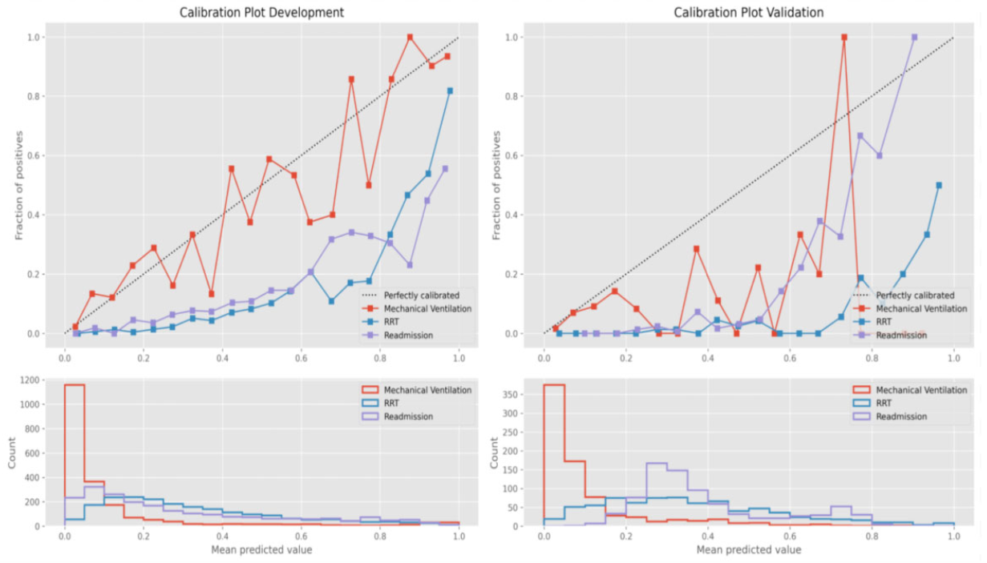
CALIBRATION
Figure shows the calibration curves for each outcome’s.
In the development cohort, predicted probabilities for mechanical ventilation closely approximate the observed fraction of positive cases.
Meanwhile, for both RRT and readmission, the predicted probabilities overestimate the fraction of positive cases.
Similar trends are observed for calibration in the validation cohort.
Notes:
Questo metodo è utilizzato per visualizzare la calibrazione di un classificatore. Gli esempi vengono raggruppati in bins in base alla probabilità predetta del modello P(C+|X). Per ciascun bin, viene calcolata la probabilità vera come numero di occorrenze della classe C+ all'interno del bin.
This method is used to visualize the calibration of a classifier. Examples are grouped into bins based on the predicted probability of the model P(C+|X). For each bin, the true probability is calculated as the number of occurrences of the C+ class within the bin.

Slide 16
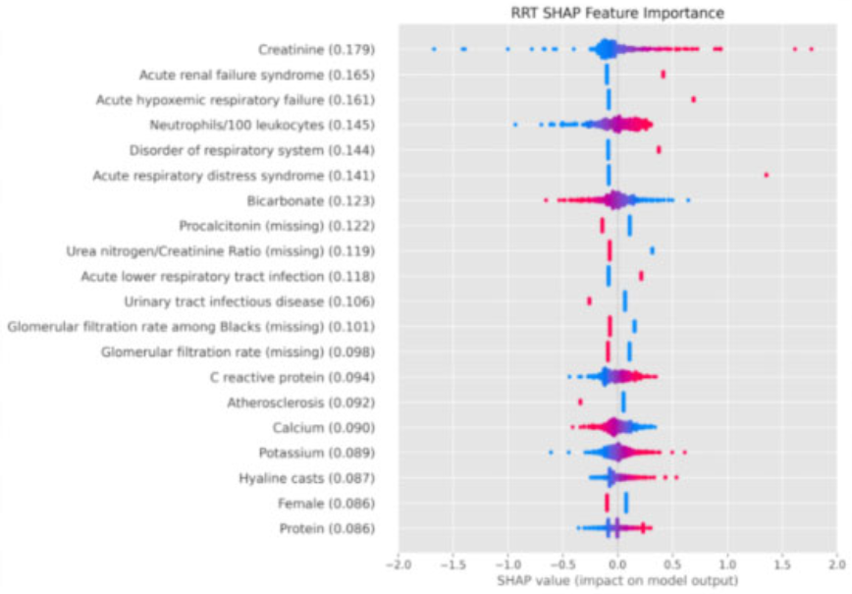
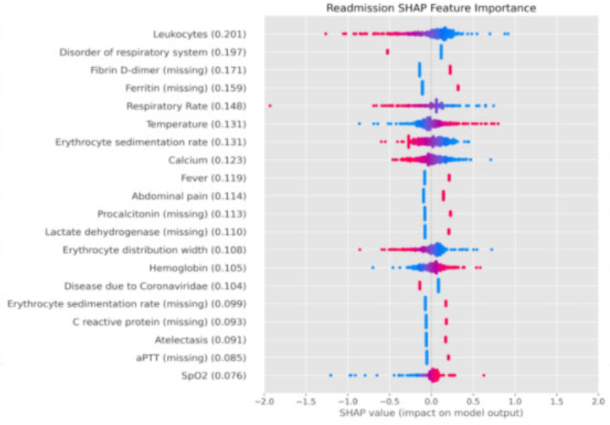
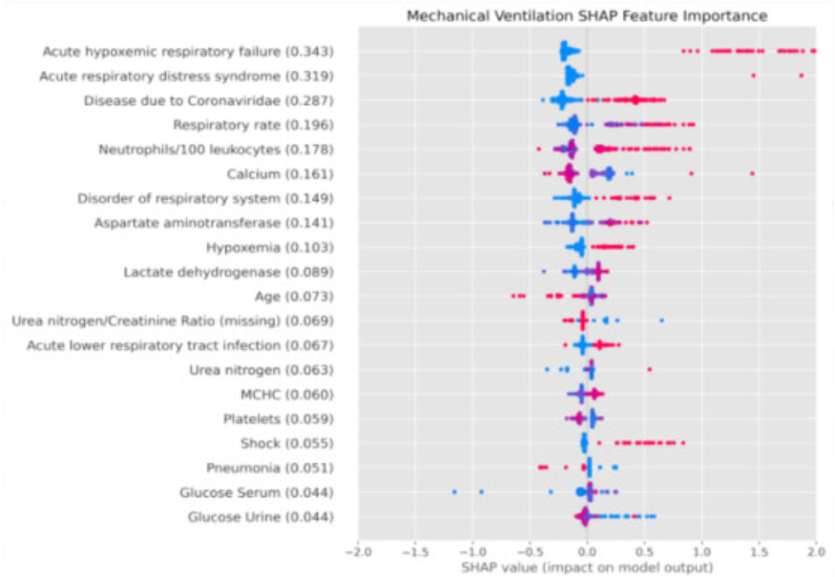
FEATURE IMPORTANCE
Feature importance for all models were evaluated using SHAP.
SHAP allows for instance-wise visualization, which for a given feature can demonstrate the distribution of the effect size and direction across the cohort.
Notes:
TRADUZIONE SLIDE:
L'importanza delle caratteristiche per tutti i modelli è stata valutata usando SHAP.
SHAP permette la visualizzazione per istanza, che per una data caratteristica può dimostrare la distribuzione della dimensione e della direzione dell'effetto in tutta la coorte.

Slide 17
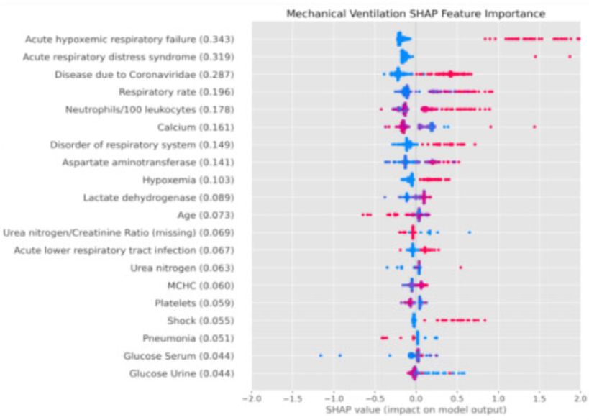
Using shap for features
SHAP feature importance's for ventilation, renal replacement therapy (RRT), and readmission.
Each SHAP value plot displays a patient-level SHAP value as a point which lies on the horizontal axis and uses colour to indicate whether the feature value for a patient was higher (red) or lower (blue) than average.
SHAP values >1 indicate increased risk for a patient. SHAP values <1 indicate decreased risk.
Notes:
Positive Predictors (positive SHAP values) are:
Respiratory illnesses including:
acute hypoxemic respiratory failure
acute respiratory distress syndrome (ARDS)
acute lower respiratory tract infection for mechanical ventilation
High respiratory rate
high neutrophil count
hypoxemia
Shock
documented disease due to coronaviridae (ie, the presence of the concept code “Disease due to Coronaviridae” in a patient’s clinical record)
Negative predictive (negative SHAP values) are:
Greater age

Slide 18
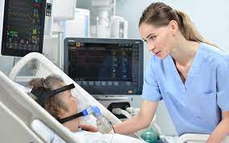
DISCUSSION
The final development and validation cohorts contained 2256 and 855 patients, respectively. The distributions were not significantly different between cohorts of :
sex
race
number of readmissions.
Significant differences were found in the distributions of:
age
Ethnicity
numbers of mechanical ventilation
RRT cases
numbers of patients with do not intubate or do not resuscitate status or who died during their hospitalization

Slide 19
Their models demonstrate strong performance on the development cohort, must also acknowledge that this performance deteriorates significantly when they are applied to the validation cohort.
The development cohort was drawn from a MAJOR MEDICAL CENTER
The validation cohort came from SMALL COMMUNITY HOSPITAL
It is likely that these 2 populations contain very different people who experience very different care practices

Slide 20
PERSONAL REFLECTION
This paper was very interesting and the subject is extremely current considering the global situation.
We recommend reading this paper to people who are keen on ML .

Slide 21
Definizione del problema e degli obiettivi dell’analisi dei dati
Introduzione al database
Descrizione del database:
Comprensione e preparazione dei dati.
Analisi degli attributi
Trattamento dei dati mancanti
Selezione degli attributi
4. I modelli
5. Valutazione, confronto e scelta del modello
6. Valutazione e confronto tra modelli
7. Utilizzo dei modelli / Conclusione

Slide 22
Thank you for your attention

